Slide 1
CMPE 211Project

Slide 2
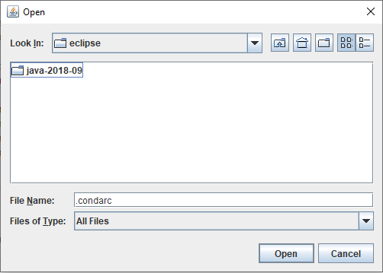
GUI

Slide 3
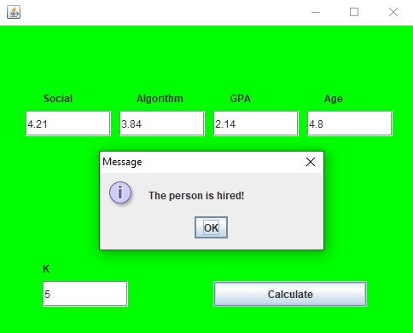

Slide 4
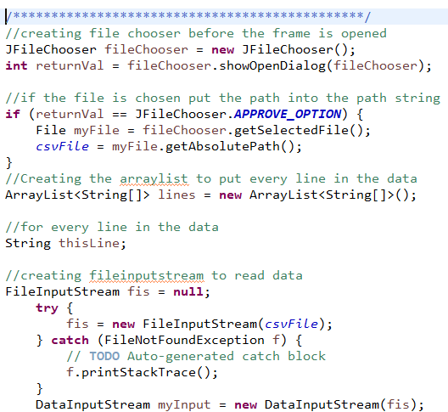
File and data input
Creating a FileChooser before the Frame is visible.
ArrayList is also created to store the data.

Slide 5
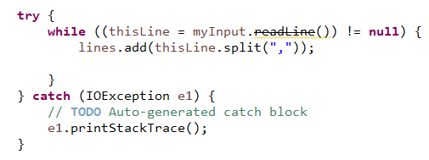
Data reading
Reading the data from the txt file.

Slide 6
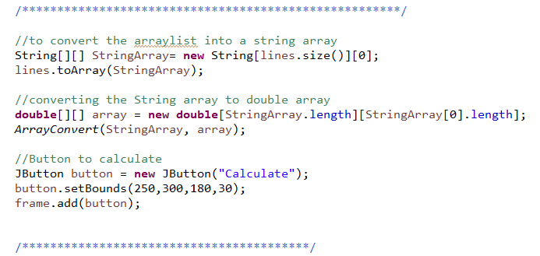
Converting the arraylist
Converting the ArrayList into String array.
String array is also converted into double array so they can be manipulated.

Slide 7
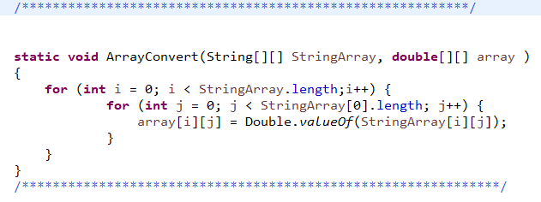
Array convert
Each of the String is converted to double and then put in the double array.

Slide 8
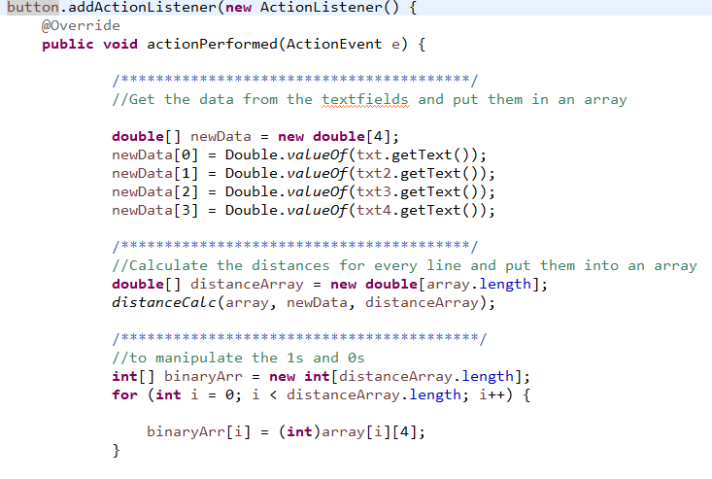
Action listener
Get the data from the user and put them into an array.
Calculate the distance for each of the candidate and put them in an array
Putting 1/0 into an array from the original array

Slide 9
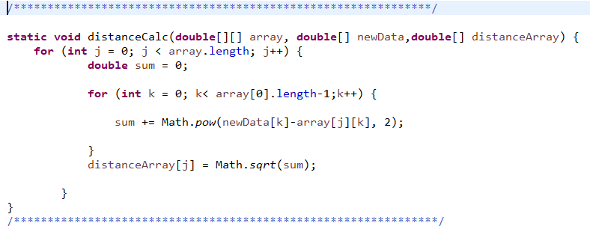
Euclidean distance

Slide 10
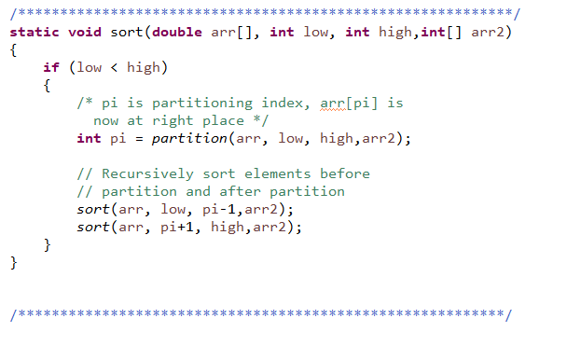
Quick sort

Slide 11
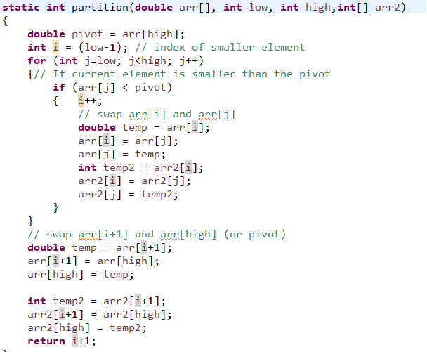
partition

Slide 12
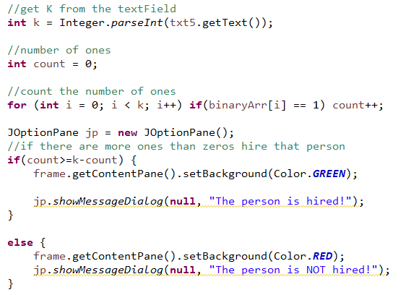
K nearest

